Slide 1
Joining Tables in MySQL

Slide 2

Joining Tables in MySQL
What is a Join?
Combining rows from two or more tables based on a related column.
Essential for relational database queries.
Why Use Joins?
Retrieve meaningful data from multiple tables.
Optimize data organization and access.

Slide 3
Types of Joins Overview Inner Join: Returns rows where there is a match in both tables. Left Join (Left Outer Join): Returns all rows from the left table and matched rows from the right. Right Join (Right Outer Join): Returns all rows from the right table and matched rows from the left. Full Join (Full Outer Join): Combines rows when there is a match in one or both tables.

Slide 4

Inner Join
Definition: Fetches records with matching values in both tables.
Syntax:
SELECT columns FROM table1 INNER JOIN table2 ON table1.common_column = table2.common_column;
Example:
Tables: Employees and Departments.
SELECT Employees.name, Departments.department_name FROM Employees INNER JOIN Departments ON Employees.department_id = Departments.id;

Slide 5
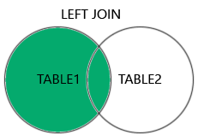
Left Join
Definition: Fetches all rows from the left table and matched rows from the right table; unmatched rows in the right table return NULL.
Syntax:
SELECT columns FROM table1 LEFT JOIN table2 ON table1.common_column = table2.common_column;
Example:
SELECT Employees.name, Departments.department_name FROM Employees LEFT JOIN Departments ON Employees.department_id = Departments.id;

Slide 6
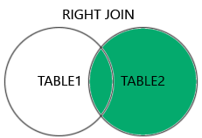
Right Join
Definition: Opposite of Left Join; fetches all rows from the right table and matched rows from the left.
Syntax:
SELECT columns FROM table1 RIGHT JOIN table2 ON table1.common_column = table2.common_column;
Example:
SELECT Employees.name, Departments.department_name FROM Employees RIGHT JOIN Departments ON Employees.department_id = Departments.id;

Slide 7
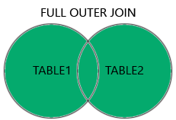
Full Outer Join
Definition: Returns all rows when there is a match in one or both tables; unmatched rows are filled with NULL.
Syntax:
SELECT columns FROM table1 FULL OUTER JOIN table2 ON table1.common_column = table2.common_column; Example SELECT e.employee_id, e.name AS d.department_id, d.department_name FROM Employees e LEFT JOIN Departments d ON e.department_id = d.department_id UNION SELECT e.employee_id, e.name AS employee_name, d.department_id, d.department_name FROM Employees e RIGHT JOIN Departments d ON e.department_id = d.department_id;

Slide 8
CONCLUSION
In conclusion, mastering table joins in MySQL is essential for effectively working with relational databases. Joins allow you to combine data from multiple tables, enabling you to extract meaningful insights and create robust queries for real-world applications. From INNER JOIN, which retrieves only matching rows, to LEFT JOIN and RIGHT JOIN, which include unmatched data from one table, and the simulated FULL OUTER JOIN, which ensures a comprehensive view by including unmatched data from both tables, each type of join serves a specific purpose. Understanding when and how to use these joins is crucial for optimizing data analysis, enhancing database performance, and delivering impactful results. By practicing with sample datasets and using these techniques effectively, you can unlock the full potential of relational databases in any data-driven project.

Slide 9
Thank you
If you have any question?
thahliyamist@gmail.com

